Slide 1
Knowledge Mining with Azure Search

Slide 2
IMPORTANT! Did you do the workshop pre-requisites ? https://aka.ms/kmw1 (Module 0)

Slide 3
Azure AI
a
b
AI apps & agents
Knowledge mining
Machine learning
Notes:
AI is driving transformation across industries and empowering companies to think about their business in completely new ways.
But in order to really take advantage of AI, you need to be able to build a powerful solution.
There are three main solutions you can build with Azure AI:
Build AI apps and agents that can interact with users naturally, with pre-trained AI models and bots
Unlock insights lying latent in your content with Knowledge Mining
Build your own AI machine learning models

Slide 4
Azure AI
a
b
AI apps & agents
Knowledge mining
Machine learning
Azure Search
Form Recognizer
Notes:
AI is driving transformation across industries and empowering companies to think about their business in completely new ways.
But in order to really take advantage of AI, you need to be able to build a powerful solution.
There are three main solutions you can build with Azure AI:
Build AI apps and agents that can interact with users naturally, with pre-trained AI models and bots
Unlock insights lying latent in your content with Knowledge Mining
Build your own AI machine learning models

Slide 5
What is knowledge mining?
Unlock valuable information lying latent in all your content in order to perform an action or make decisions
Form 5471
Your documents
Notes:
Unlock valuable information lying hidden in all your content in order to perform an action or make decisions.
Why do you need AI for this?
Problem is scale.
Innovations across vision, speech, language, knowledge, and search mean for the first time it’s possible for our applications to interpret unstructured data in a human-like fashion, and to more deeply understand traditional data in the form of text.

Slide 6


Notes:
Scale…….World is messy……Actual customer
Problem not specific to one customer.
One of the biggest challenges that we have is that a lot of that data has latent content that we have not yet been understood or unleashed.
This is an actual picture of a customer that shall not be named – as it turns out the best way to do a Denial of Service on a legal firm is to provide them data that is not structured…
World is messy. Don’t focus on how this content isn’t scanned.
This problem isn’t specific to this one customer.
Understanding latent value in all content through the use of AI technologies creates more efficiency and understanding.
Think through the number of years it would take a human to go through, catalog, and pull out relevant metadata and find patterns in millions of documents. With Azure Cognitive Search this process can be done automatically with the help of Azure Cognitive Services and even custom AI services.

Slide 7



2.5
quintillion bytes
$14,209
80%
Productivity lost per knowledge worker each year due to information searches
Data created in the world per day
Percentage of unstructured data
Notes:
This problem isn’t specific to this one customer.
The reality of the world today is that information is constantly generated--Forbes recently estimated that the world creates over 2.5 quintillion bytes of new data per day.
It’s also coming in more “unstructured” formats like PDFs, images, videos, audio files, and powerpoints decks. Around 80% of this data in businesses is estimated to be unstructured.
As a result, it can cost time and money. Internally, decisions are less informed, take longer to make, work is done manually, Externally, user experience on apps can be difficult to naviate, and customers may not be able to find relevant content and products.
Information has the potential to become an asset or a burden, depending on how you use it. So we’re all faced with a similar challenge: how do we apply our information meaningfully to our products and businesses?
The reality of the world today is that information is constantly generated--Forbes recently estimated that the world creates over 2.5 quintillion bytes of new data per day. Data is coming in “unstructured” formats like PDFs, images, videos, audio files, and Powerpoints decks. In fact, around 80% of data in businesses is estimated to be unstructured.
As a result, it can cost time and money. Internally, decisions are less informed, take longer to make, work is done manually, Externally, user experience on apps can be difficult to navigate, and customers may not be able to find relevant content and products.
Information has the potential to become an asset or a burden, depending on how you use it. So how do we apply our information meaningfully to our products and businesses?
1. https://www.ricoh.nl/Images/IDC_Executive_Insights_January2011_t_76-4420.pdf
2. http://www.marketingpilgrim.com/2014/12/in-the-next-60-seconds-300-hours-of-video-will-be-uploaded-to-youtube.html

Slide 8
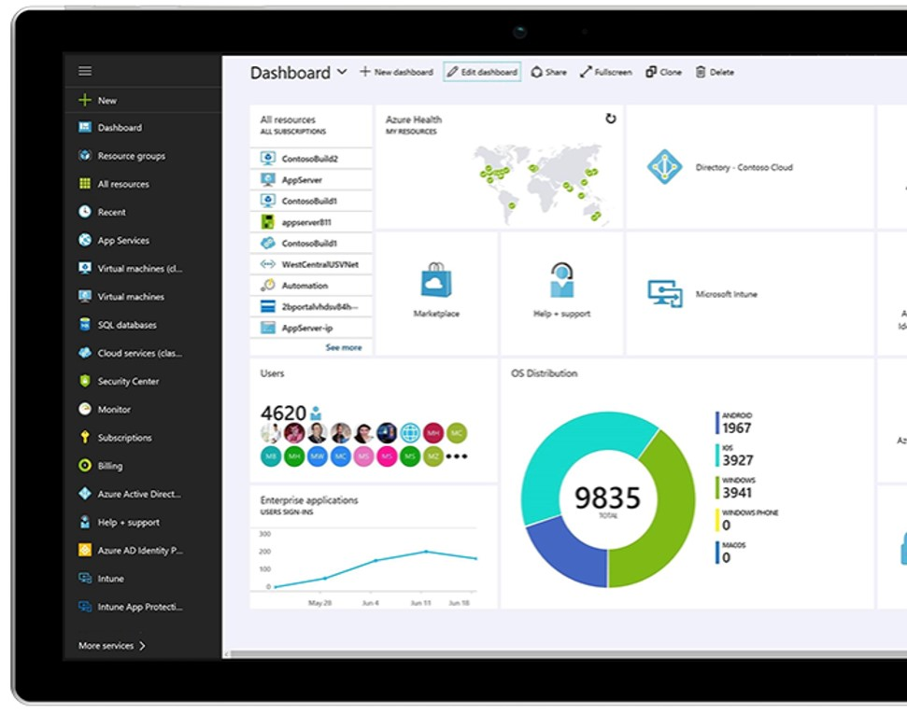
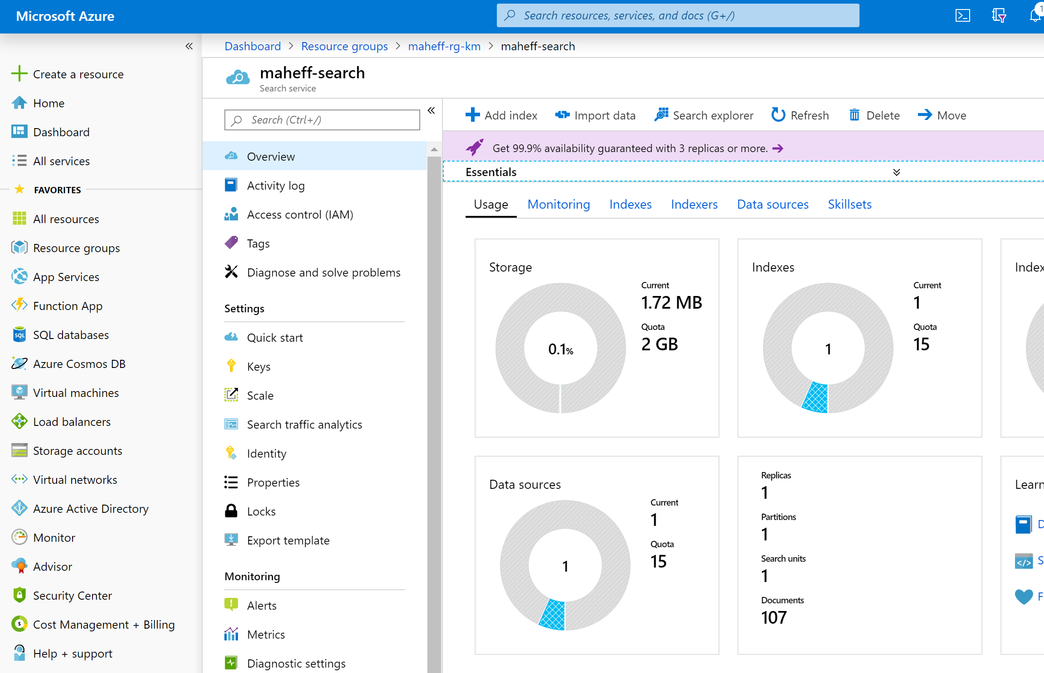
management free keyword search faceting language analyzers geospatial support suggestions/auto-complete customizable scoring proximity search synonyms complex types etc.
Azure Search Search-as-a-Service
Notes:
We started this journey with Azure Search, a down-to-earth search as a service product with all the capabilities that you would expect from a search service.
You connected your data source to our service, we would index the information in the data source. We were able to tell when the data sources changed to keep your search index up to date.
It supports different data sources such as CosmosDB, Blob storage and Azure SQL.
We received some clear feedback that files were not all structured (like JSON files). Our customers wanted us to be able to read a variety of documents.

Slide 9
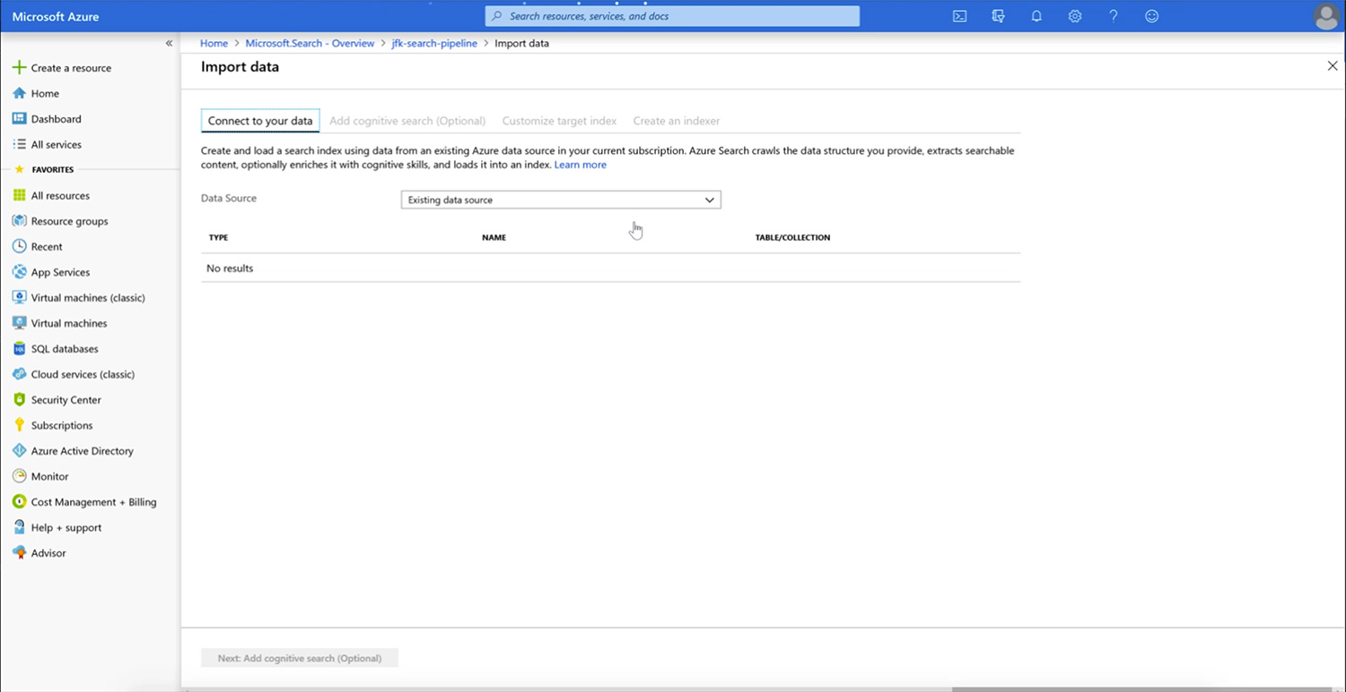
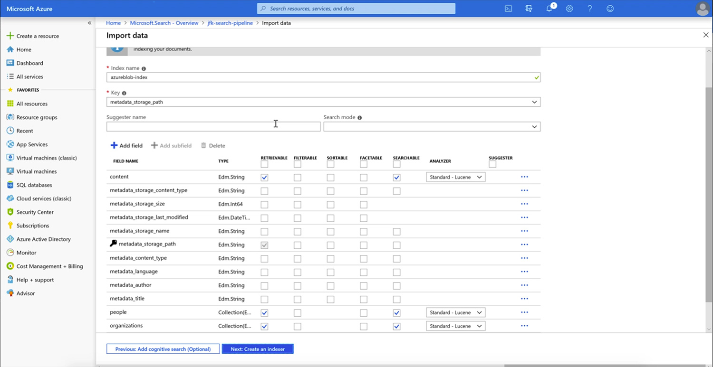
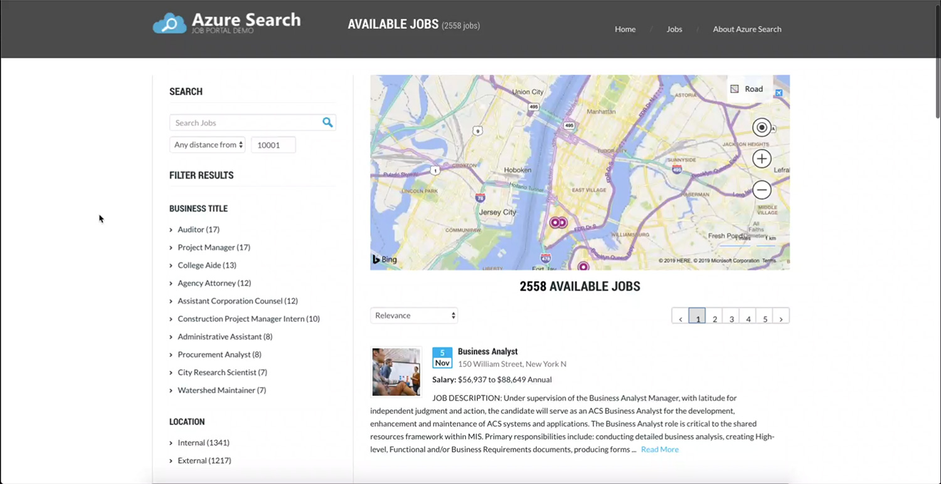
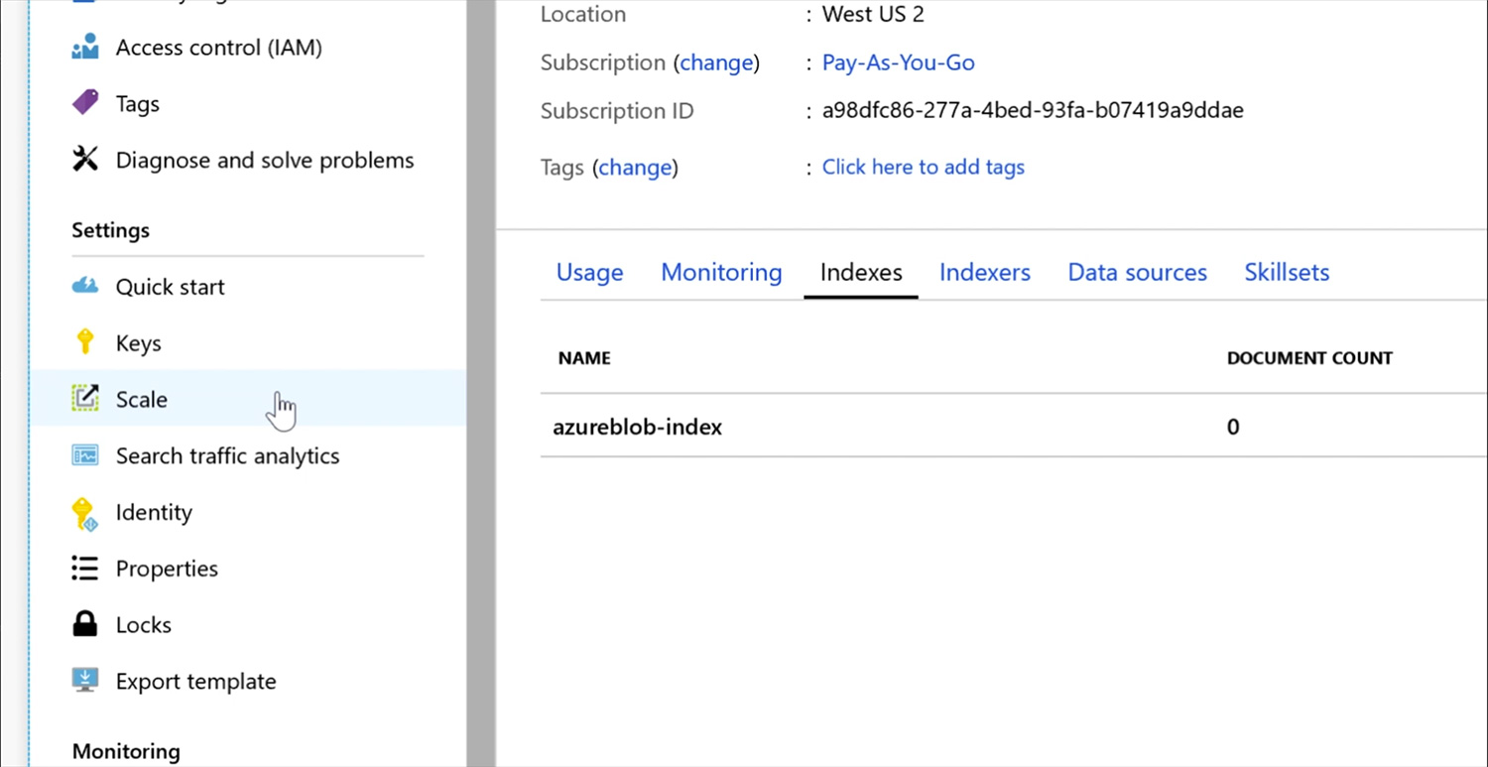
Effortlessly Implemented
Start, Maintain, and Scale with limited investment
Ingest structured and unstructured data + easily pull from Azure Data stores
Quickly configure, no coding required
Rich search features, out-of-the-box
Easily scale and maintain
Notes:
Creating a search experience is a notoriously long and difficult process. You need to write code to ingest your information, organize it and categorize it into different fields, analyze the languages that are present it, and stem the content in order to create a search index. Once you’ve gotten all that information organized, your end interface has to understand the intent of people’s searches, their language, the relevance of different things they are looking for, and countless other nuances to prioritize and serve the content.
We’ve simplified this with Azure Search, so if you don’t want to, you never have to look into at a single file within your data source or touch a line of code. Out-of-the box, you can provision search by clicking through a friendly UX in our Azure Search portal, and we on the backend will pull your information in from any azure storage solution so you don’t have to worry about the hassle. Our AI capabilities come out of the box to convert unstructured information—documents, pictures, PDFs, ppt presentations, into searchable content without any extra effort from you. And, we’re offering you all the rich search tools from our decades of investment in search to categorize, filter, and optimize the final end-search interface.
Since this is a managed search service, not only can you quickly set up search, but you don’t have to worry about the upkeep. Usually, Managing a search engine requires a dedicated staff with specialized skills in search. Instead, we take care of the burden by doing things like checking your data source in case you are adding and deleting from it frequently so that your final solution is always up to date. Also on the backend we’re adding and maintaining VMs during high traffic periods in order to scale the solution to you needs.
Deploy a search index quickly and avoid operational maintenance with Azure Search. The fully managed service reduces the complexity of data ingestion and index creation by integrating with popular Azure storage solutions and offering index functionality exposed through a simple REST API or .NET SDK. You can quickly deploy a fully-configured search service with intuitive user experiences like scoring, faceting, suggestions, synonyms, and geo-search - all while avoiding the operational overhead needed to debug index corruption, monitor service availability, or manually scale during traffic fluctuations.

Slide 10
Cognitive Search Pattern
Ingest
Enrich
Explore
Data in any format, any Azure store
Skillset
Search
Annotations
Notes:
Even as we take in all of this complexity, as we looked at these challenges, we saw a common pattern emerge:
INGEST (Understanding documents in a variety of format)
AUGMENT (Extract “information”, Create structure out of the unstructured.)
EXPLORE (Search)
INGEST (Understanding documents in a variety of formats)
ENRICH (Extract “information”, Create structure out of the unstructured, find patterns, gain understanding across multiple document types)
EXPLORE (Search intelligently to create knowledge from disparate documents, and structured and unstructured data)

Slide 11

Cognitive Search A new capability of Azure Search
IEnricher
IEnricher
Cognitive Skill
Document Cracking
Skillset:
Extensible enrichment
pipeline
Source Data
Enriched Documents
Search Index
INGEST
ENRICH
EXPLORE
Notes:
New!!
As you saw, the Cognitive Search pipeline contains a number of AI-driven capabilities (image extraction, entity and key phrase extraction, language detection and more) not just extracting information, but enriching it with additional metadata.
But we know that you business scenario may have unique needs beyond these core skills, so we also provide you with the ability to add custom skills…..

Slide 12
Cognitive Search A new capability of Azure Search
IEnricher
IEnricher
Cognitive Skill
Document Cracking
Skillset:
Extensible enrichment
pipeline
Source Data
Enriched Documents
Search Index
INGEST
ENRICH
EXPLORE
Notes:
New!!
As you saw, the Cognitive Search pipeline contains a number of AI-driven capabilities (image extraction, entity and key phrase extraction, language detection and more) not just extracting information, but enriching it with additional metadata.
But we know that you business scenario may have unique needs beyond these core skills, so we also provide you with the ability to add custom skills…..

Slide 13
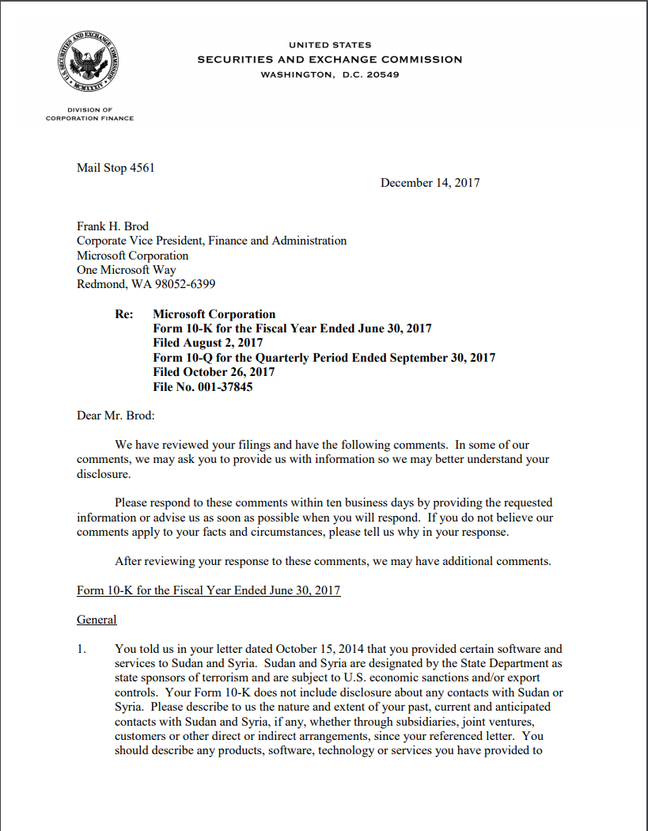

Document Cracking
Built-in connectors
Blob Storage
Azure SQL
Cosmos DB
Azure Tables
ADLS Gen2 (new! - gated public preview!)
File formats supported in blob storage
text
metadata
images
pdf
xml
png
rtf
json
html
doc
ppt
xls
jpg
tiff
bmp
Notes:
MongoDB?

Slide 14
Cognitive Search A new capability of Azure Search
IEnricher
IEnricher
Cognitive Skill
Document Cracking
Skillset:
Extensible enrichment
pipeline
Source Data
Enriched Documents
Search Index
INGEST
ENRICH
EXPLORE
Notes:
New!!
As you saw, the Cognitive Search pipeline contains a number of AI-driven capabilities (image extraction, entity and key phrase extraction, language detection and more) not just extracting information, but enriching it with additional metadata.
But we know that you business scenario may have unique needs beyond these core skills, so we also provide you with the ability to add custom skills…..

Slide 15
Built-in Skills in Multiple Languages
Natural Language Processing
Key Phrase Extraction Sentiment Analysis Organization Entity Extraction Location Entity Extraction Persons Entity Extraction Language Detection Text Translation
Image Processing
Face Detection Tag Extraction Celebrity Recognition Landmark Detection Handwriting Recognition Printed Text Recognition
Utilities
Complex Type Shaping Text Merging Text Splitting Conditional Skill

Slide 16
Sample skillset
text
organization entity recognition
merge text
normalized_images
location entity recognition
OCR (text recognition)
Notes:
Call out:
We have a language to all for a more organized flow – you might have many images in a doc
Schema to represent enrichments
We can do this at scale

Slide 17
Demo: Portal Enrichments

Slide 18




Cognitive skills
Built-in skills
Custom skills
Key Phrase extraction
Location entity extraction
Sentiment analysis
Your custom skill goes here!
Organization entity extraction
Persons entity extraction
Language detection
Face detection
Celebrity recognition
Image tag extraction
Text Utilities
Landmark detection
Printed text recognition
Azure Databricks
Azure Machine Learning
Machine Learning VMs

Slide 19
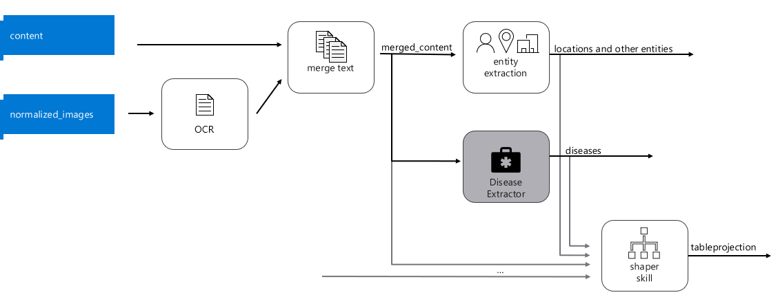
Sample skillset with custom skills

Slide 20
Cognitive Search A new capability of Azure Search
IEnricher
IEnricher
Cognitive Skill
Document Cracking
Skillset:
Extensible enrichment
pipeline
Source Data
Enriched Documents
Search Index
INGEST
ENRICH
EXPLORE
Notes:
New!!
As you saw, the Cognitive Search pipeline contains a number of AI-driven capabilities (image extraction, entity and key phrase extraction, language detection and more) not just extracting information, but enriching it with additional metadata.
But we know that you business scenario may have unique needs beyond these core skills, so we also provide you with the ability to add custom skills…..

Slide 21
Cognitive Search Demos
JFK, WK, Met
Notes:
NOTE: Met Art Explorer is currently undergoing maintenance and may not be available for customer demo
JFK Files: https://jfk-demo.azurewebsites.net/#/ - oswald
Wolters Kluwer: http://wolterskluwereap.azurewebsites.net/Home/Index - Microsoft
Wolters Kluwer is a global information services company. Information Services - Professionals in this sector provide information to the public or to specific companies, industries or groups of people. As well as providing the information, be it hard copy or electronic, information professionals also organize and store information.
Our priority is providing timely, actionable insights in an end-to-end digital environment that empowers them to make informed decisions and deliver impact when it matters most.
SEC filings
Wolters Kluwer empowers attorneys to more quickly find the information they need, this is especially important because the time of an attorney is precious (they bill by the 6 minute increment).
Met Art Explorer: https://art-explorer.azurewebsites.net/ - boat paining
Contoso (Howden): https://contoso-manufacturing.azurewebsites.net/home
Resume: https://careersearchui.azurewebsites.net/
FEMA: http://femademo724-site.azurewebsites.net/

Slide 22
Common Scenarios

Slide 23
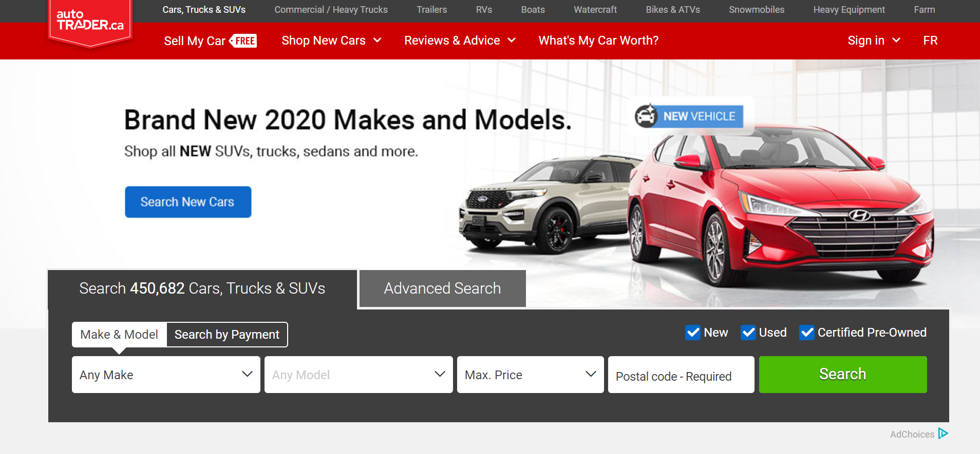
Auto Trader
Notes:
Pain point:
Driving growth and building traffic with audience and getting them to engage deeper down the funnel by serving the most relevant information.
Example Scenario: Need immediate and customer relevant updates to online product catalogs
A Retailer wants to quickly move their products online, but does not have the skills, knowledge, or time to build their own search engine.
In order to move quickly, they use Azure Search to ingest their product descriptions, images, and pricing catalogues in order to create a search index that is surfaced via Azure Web App to their customers.
Azure Search automatically crawls their data at a regular interval in order to update the search index in case products are out of stock or new products are added to their inventory.

Slide 24
Catalogue search
Surface relevant product details for your customers
Azure search
Ingest
Search index
Explore
Products, pricing catalogue, orders
Invoicing sales
Azure Web App
Azure Storage
Notes:
Consumption: #Azure search services, segment your data to make it closer to the region its executed in
Data segmentation to optimize for consumption resource consumption (front-end webpage; internal invoicing sales application)

Slide 25

Icertis
Leading enterprise contract management platform on the Microsoft Cloud
Notes:
Icertis has a contract management platform. They would like to extract insights from contracts by extracting structured information (such as risk, and the particular type of clauses identified in a document) from very unstructured documents (contracts that they customers have in a variety of formats like PDF and Word format)
Identify clauses, GDPR risk scoring
Because contracts start out as inherently unstructured data, Icertis AI technology enables companies to solve previously intractable enterprise contract management challenges that are uniquely suited to AI-powered solutions. We have infused AI across the Icertis Contract Management platform (ICM) to provide deeper insights, facilitate better decision making, and to automate high-scale, repetitive processes.
With the help of technologies like Azure Cognitive Services and Machine Learning, Icertis has created a family of AI applications that enable our customers to:
Easily digitize and semantically map unfamiliar third-party contracts into the ICM platform
Find hidden risks and obligations within contracts without extensive manual review
Make smarter decisions with automatic recommendations for the best contract terms and optimal clause language from past successful negotiations
Better understand and surface complex relationships between thousands of contracts across the entire enterprise
Benefits:
Import legacy contracts up to 80% faster, with the semantics described in ICM. Rapidly set up third party contracts with the same flexibility as with your own paper.
Reduce risk and improve compliance with AI-powered insights into contract clauses and obligations - improving post-execution compliance by up to 90%.
Reduce the cost of compliance by up to 60% and discover new revenue opportunities in legacy contracts.

Slide 26
Classifiers and custom alerts
Understand your data with filtering and signal enablement
Azure Search and Cognitive Services with Machine Learning
Ingest
Enrich
Cognitive skills
Custom skills
Search index
Explore
Images
Key phrase extraction
Clause extraction
Risk identifier
Document cracking (OCR)
Language detection
Automatic translation
PDFs
Azure Blob Storage
Azure Web App
Entity extraction
Notes:
Pain point:
Knowledge management within/across teams, Identifying risks, discrepancies, or new business opportunities over a massive set of structured and unstructured content, making business decisions over an incomplete set of “usable” information
Example Scenario: Finding and extracting data from contracts:
Accurately parsing contracts into clause sections and extracting key metadata within scanned legacy contract PDF’s and Word documents.
Domain specificity of legal language, means that entity identification and finding similar words or phrases can be very difficult difficult.
Save significant time and streamline contract review processes.
Reduce risk by identifying risky language and important phrases

Slide 27
The Azure Search Difference
Extract value from a wide range of structured and unstructured data and apply it to your website, application, or business solution
Effortlessly Implemented
Easily Integrated
Readily Customizable
Effortlessly implement a best-in-class search engine
Easily and quickly integrate AI
Customize to your unique business needs
Secure
Stay confident with a secure and compliant foundation
Notes:
Over the last year we’ve enlightened Azure search to be one of the corner stones of knowledge mining in Azure
Encryption extends throughout the entire indexing pipeline: from connections, through transmission, and down to indexed data stored in Azure Search.
This platform as a service (PaaS) offering makes it incredibly easy to build a solution that ingests information, synthesizes it and surfaces what is relevant to the user. And even though it’s a platform, you still have the power to mold your final solution by integrating custom skills and incorporating your own models or data into the final product. And as with all Azure products, we take your security and privacy concerns seriously, so that you can trust enabling search for your business and customers.
At the core of every search problem, a product needs to be able to take in information, synthesize it, and surface the relevant components of it. This platform offering makes it incredibly easy to build a product that does just that AND integrates AI capabilities for an even deeper search. Even though it’s a platform, you still have the power to mold your final solution by integrating custom skills and incorporating your own models or data into the final product. And, like all Azure products, we take your security and privacy concerns seriously, so that you can trust enabling search for your business and customers.

Slide 28
Advanced Azure Search Topics

Slide 29
Topics
Analyzers
Synonyms
Complex Types
Push API
Scoring and Scoring Profiles
Security Trimming
IP Filtering & VNETs
Multi-tenancy

Slide 30
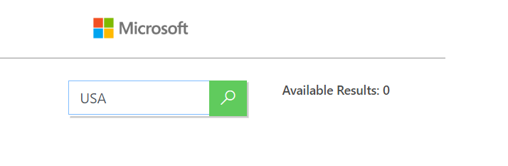
Synonyms
What if we’re searching for documents that contain the words United States, but the user types in USA?
Search returns 0 results!

Slide 31
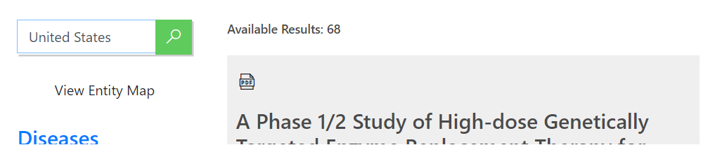
Synonyms
Synonym maps are used to expand the scope of a query, without having to explicitly provide the term
In Azure Search, synonym expansion is done at query time
Ex: associate ‘United States’ with ‘USA’
Notes:
In Azure Search, synonym expansion is done at query time
Add synonymMaps property to a field definition without having to rebuild the index
Synonym maps are maintained independently of the index.
Changes to the synonym map is always a whole-document operation.
Synonym maps are uploaded via POST or PUT
Each rule delimited by the new line character (‘\n’)
Define up to 5,000 rules per synonym map (free) and 10,000 in all other SKU’s with each rule having up to 20 expansions
SynonymMaps can be specified for searchable fields of the type ‘Edm.String’ or ‘Collection(Edm.String)’

Slide 32
1. Define Synonym Map
POST https://[servicename].search.windows.net/synonymmaps?api-version=2019-05-06
api-key: [admin key]
{
"name":"mysynonymmap",
"format":"solr",
"synonyms": "
USA, United States, United States of America\n
Washington, Wash., WA => WA\n"
}
Notes:
Create synonym map
Tell index definition to use it
Configure the field to use the synonym maps
Synonym maps are maintained independently of the index.
Changes to the synonym map is always a whole-document operation.
Synonym maps are uploaded via POST or PUT
Each rule delimited by the new line character (‘\n’)
Define up to 5,000 rules per synonym map (free) and 10,000 in all other SKU’s with each rule having up to 20 expansions
SynonymMaps can be specified for searchable fields of the type ‘Edm.String’ or ‘Collection(Edm.String)’

Slide 33
2. Configure Index
POST https://[service name].search.windows.net/indexes?api-version=2019-05-06
api-key: [admin key]
{
"name":"myindex",
"fields":[
{
"name":"id",
"type":"Edm.String",
"key":true
},
{
"name":"name",
"type":"Edm.String",
"searchable":true,
"analyzer":"en.lucene",
"synonymMaps":[
"mysynonymmap"
]

Slide 34
Complex Types
{
"HotelId": "1",
"HotelName": "Secret Point Hotel",
"Description": "The hotel is ideally located on the main commercial artery of the city in the heart of New York.",
"Tags": [ "pool", "air conditioning", "concierge" ],
"Rating": 3.60,
"Category": "Boutique",
"Address": {
"StreetAddress": "677 5th Ave",
"City": "New York",
"State": "NY",
"ZipCode": "10022"
},
"Rooms": [
{
"Description": "Budget Room, 1 Queen Bed (Cityside)",
"BaseRate": 96.99,
"BedOptions": "Queen Bed",
"SleepsCount": 2,
"Tags": [ "vcr/dvd" ]
},
{
"Description": "Budget Room, 1 King Bed (Water View)",
"Type": "Budget Room",
"BaseRate": 80.99,
"BedOptions": "King Bed",
"SleepsCount": 2,
"Tags": [ "vcr/dvd", "jacuzzi tub" ]
}
}
Data often includes hierarchical or nested substructures that do not break down neatly into a tabular row-sets such as:
Multiple locations for a single customer
Multiple colors and sizes for a single SKU
Multiple authors of a single book
Notes:
AI adds to this need with additional enriched data
In modeling terms, you might see these structures referred to as complex data types, compound data types, composite data types, or aggregate data types, to name a few

Slide 35
Support for Complex Types
OBJECT
{
"region": "US",
"manager": {
"age": 30,
"name": {
"first": "John",
"last": "Smith"
}
}
}
NESTED
{
"group": "fans",
"user": [
{
"first": "John",
"last": "Smith"
},
{
"first": "Alice",
"last": "White"
}
]
}
Edm.ComplexType
Represents a single complex object. It can contain other complex types (String, Integer, Long, Double, Boolean, DateTimeOffset & GeoPoint)
Collection(Edm.ComplexType)
Represents a collection of complex objects. Like a nested document. Can contain other complex types.
Notes:
Adds support for searching, faceting and filtering of complex values:
Do we want to want to show how we are using Complex Types in either Howden or the data from the Face API for build demo

Slide 36
Sample Complex Type in the Index Definition
{
"name": "hotels",
"fields": [
{ "name": "HotelId", "type": "Edm.String", "key": true, "filterable": true },
{ "name": "HotelName", "type": "Edm.String", "searchable": true, "filterable": false },
{ "name": "Description", "type": "Edm.String", "searchable": true, "analyzer": "en.lucene" },
{ "name": "Address", "type": "Edm.ComplexType",
"fields": [
{ "name": "StreetAddress", "type": "Edm.String", "filterable": false, "sortable": false, "facetable": false, "searchable": true },
{ "name": "City", "type": "Edm.String", "searchable": true, "filterable": true, "sortable": true, "facetable": true },
{ "name": "StateProvince", "type": "Edm.String", "searchable": true, "filterable": true, "sortable": true, "facetable": true }
]
},
{ "name": "Rooms", "type": "Collection(Edm.ComplexType)",
"fields": [
{ "name": "Description", "type": "Edm.String", "searchable": true, "analyzer": "en.lucene" },
{ "name": "Type", "type": "Edm.String", "searchable": true },
{ "name": "BaseRate", "type": "Edm.Double", "filterable": true, "facetable": true }
]
}
]
}
Notes:
Adds support for searching, faceting and filtering of complex values:
Do we want to want to show how we are using Complex Types in either Howden or the data from the Face API for build demo

Slide 37
Complex Type Query Sample
Use lambda expressions for complex type filters
Example: Filter hotels where all of the rooms are non-smoking and have at leas one deluxe room.
$filter= Rooms/any(room: room/Type eq 'Deluxe Room') and Rooms/all(room: not room/SmokingAllowed)
Notes:
In Azure Search, synonym expansion is done at query time
Add synonymMaps property to a field definition without having to rebuild the index
Synonym maps are maintained independently of the index.
Changes to the synonym map is always a whole-document operation.
Synonym maps are uploaded via POST or PUT
Each rule delimited by the new line character (‘\n’)
Define up to 5,000 rules per synonym map (free) and 10,000 in all other SKU’s with each rule having up to 20 expansions
SynonymMaps can be specified for searchable fields of the type ‘Edm.String’ or ‘Collection(Edm.String)’

Slide 38
Push API
Used to programmatically send your data to Azure Search, is the most flexible approach.
Has no restrictions on data source type.
No restrictions on frequency of execution. You can push changes to an index as often as you like.
Cannot be used as part of Cognitive Search document cracking pipeline

Slide 39
Search Scoring
Score is an indicator of an item’s relevance, the higher the score, the more relevant the items.
Scoring computes a search score for each item in a rank ordered result set. Every item in a search result set is assigned a search score then ranked highest to lowest
Because of the way Azure Search computes scores across the shards, you will not always get the same score BUT the numbers should not be widely variable.
Notes:
The search score is computed based on statistical properties of the data and the query. Azure Search finds documents that include the search terms in the query string (some or all, depending on searchMode), favoring documents that contain many instances of the search term. The search score goes up even higher if the term is rare across the data index, but common within the document.
Search score values can be repeated throughout a result set. For example, you might have 10 items with a score of 1.2, 20 items with a score of 1.0, and 20 items with a score of 0.5. When multiple hits have the same search score, the ordering of same scored items is not defined, and is not stable. Run the query again, and you might see items shift position. Given two items with an identical score, there is no guarantee which one appears first.

Slide 40
Using Scoring Profiles
Scoring profiles – a customized calculation that gives you greater control over ranking items in search results.
The Scoring Profile is part of the index definition and is composed of weighted fields, functions and parameters
Notes:
The search score is computed based on statistical properties of the data and the query. Azure Search finds documents that include the search terms in the query string (some or all, depending on searchMode), favoring documents that contain many instances of the search term. The search score goes up even higher if the term is rare across the data index, but common within the document.
Search score values can be repeated throughout a result set. For example, you might have 10 items with a score of 1.2, 20 items with a score of 1.0, and 20 items with a score of 0.5. When multiple hits have the same search score, the ordering of same scored items is not defined, and is not stable. Run the query again, and you might see items shift position. Given two items with an identical score, there is no guarantee which one appears first.
Scoring Profile Example
Scoring Profile Template

Slide 41
Security Trimming
Used to trim search results based on user identity
3 Steps
Create a field that contains the principal identifiers
Push or update existing documents with the relevant principal identifiers
Apply the Security Filter
Notes:
Create a field that contains the principal identifiers
Your documents must include a field specifying which groups have access. This becomes the filter criteria against which documents are selected or rejected from the result set.
Push or update existing documents with the relevant principal identifiers
Issue an HTTP POST request to your index’s URL endpoint. The body of the HTTP request is a JSON object containing the documents to be added
Apply the Security Filter
Issue a search request with search.in filter to trim documents
POST https://[service name].search.windows.net/indexes/securedfiles/docs/search?api-version=2019-05-06
Content-Type: application/json
api-key: [admin or query key]
Specify the filter in the request body
{
"filter":"group_ids/any(g:search.in(g, 'group_id1, group_id2'))"
}

Slide 42
Security Trimming
1. Add a field that contains prinpal identifiers (i.e. group_ids)
2. Push the documents with principal identifiers information.
3. Apply Security Filter
POST https://[service].search.windows.net/indexes/securedfiles/docs/search ?api-version=2019-05-06
Request Body:
{
filter":"group_ids/any(g:search.in(g, 'group_id1, group_id2'))" }
Notes:
Best practices
Avoid equality expressions – they are difficult to maintain, error prone and may slow down query response times
Use search.in function – you can expect sub-second response times
Create a field that contains the principal identifiers
Your documents must include a field specifying which groups have access. This becomes the filter criteria against which documents are selected or rejected from the result set.
Push or update existing documents with the relevant principal identifiers
Issue an HTTP POST request to your index’s URL endpoint. The body of the HTTP request is a JSON object containing the documents to be added
Apply the Security Filter
Issue a search request with search.in filter to trim documents
POST https://[service name].search.windows.net/indexes/securedfiles/docs/search?api-version=2019-05-06
Content-Type: application/json
api-key: [admin or query key]
Specify the filter in the request body
{
"filter":"group_ids/any(g:search.in(g, 'group_id1, group_id2'))"
}

Slide 43
Security - IP Filtering & VNETs
VNETs are coming soon!
With VNETs you will be able to co locate the app that consumes the search service within the VNET, you should also be able to use Azure networking features to either restrict IP ranges that can communicate with service and/or configure a private connection with Express Route.
When using indexers, the VNET support for Azure Search will extend only to indexers that do not use skillsets or cognitive enrichments.
VNETS with Cognitive Enrichments coming at a later release.
Notes:
VNETs are coming soon!
With VNETs you should be able to co locate the app that consumes the search service within the VNET, you should also be able to use Azure networking features to either restrict IP ranges that can communicate with service and/or configure a private connection with Express Route.
When using indexers, the VNET support for Azure Search will extent only to indexers that do not use skillsets or cognitive enrichments.
The ability to use cognitive enrichments with VNETS is being deferred to a later release and I don’t have a firm estimate on when we would light up that feature.
We are working on supporting managed identities for indexers calling in to data sources and that should be something that previews this calendar year as well.

Slide 44
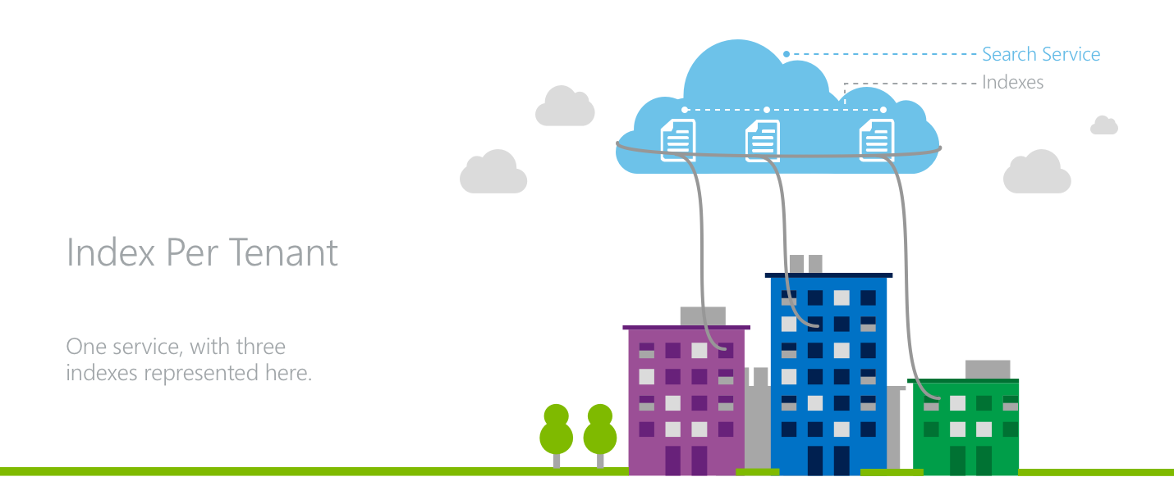
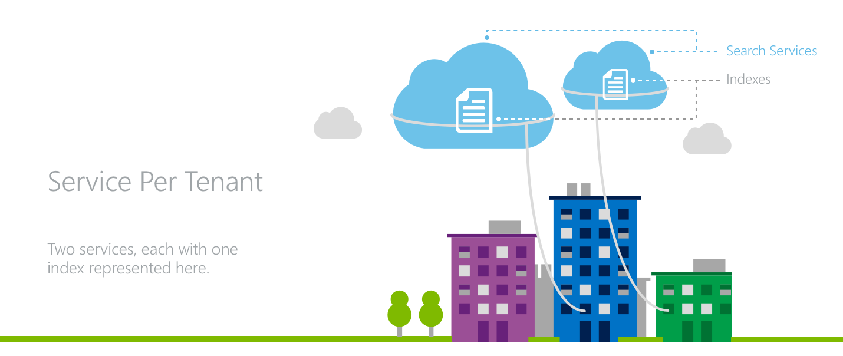
Modeling multitenancy with Azure Search
Index per tenant: Each tenant has its own index within a search service that is shared with other tenants.
Service per tenant: Each tenant has its own dedicated Azure Search service, offering highest level of data and workload separation.
Mix of both: Larger, more-active tenants are assigned dedicated services while smaller tenants are assigned individual indexes within shared services.
Notes:
Index per tenant: Each tenant has its own index within a search service that is shared with other tenants.
There is a need for awareness to direct the various tenants’ traffic to the proper indexes while also managing resources at the service level for all tenants
Service per tenant: Each tenant has its own dedicated Azure Search service, offering highest level of data and workload separation.
Maximum level of isolation for tenants, resources are not shared across various tenants workloads
Predictable, fixed cost model
Efficient for applications with a global footprint.
Mix of both: Larger, more-active tenants are assigned dedicated services while smaller tenants are assigned individual indexes within shared services.
Need to understand/predict which tenants will require dedicated service versus an index in a shared service.
Complexity increases with the need to manage both of these multitenancy models.

Slide 45
Knowledge Store

Slide 46
Let’s talk about going beyond Search
Show change in price over time
0 Results Any time
I’m sorry… this isn’t a question that can be answered with search….
Notes:
In order to do this I need to
Separate out the data of the pipeline,
Ensure it has the right shape and relationships
project it out,
Ingest it into some sort of dashboard

Slide 47
Cognitive Search A new capability of Azure Search
IEnricher
IEnricher
Cognitive Skill
Document Cracking
Skillset:
Extensible enrichment
pipeline
Source Data
Enriched Documents
Search Index
INGEST
ENRICH
EXPLORE
Notes:
New!!
As you saw, the Cognitive Search pipeline contains a number of AI-driven capabilities (image extraction, entity and key phrase extraction, language detection and more) not just extracting information, but enriching it with additional metadata.
But we know that you business scenario may have unique needs beyond these core skills, so we also provide you with the ability to add custom skills…..

Slide 48

Cognitive Search A new capability of Azure Search
IEnricher
IEnricher
Cognitive Skill
Document Cracking
Skillset:
Extensible enrichment
pipeline
Source Data
Enriched Documents
Search Index
Projections
Knowledge Store
Notes:
We had this capability on preview for a year, and during that period of time customers told us that they really enjoyed the seamless integration. They told us that the structure that we were feeding into the search index could be super useful for them for scenarios beyond search.
I am happy to announce that we added a new capability that we call the knowledge store that allows you to project the tree of information into both tabular and object shapes.

Slide 49



Cognitive Search A new capability of Azure Search
IEnricher
IEnricher
Cognitive Skill
Document Cracking
Skillset:
Extensible enrichment
pipeline
Source Data
Enriched Documents
Search Index
Analytics
Retrieval
Projections
Knowledge Store
Machine Learning
Human Validation
Notes:
In the future we plan to use this information to also support more efficient reprocessing of the information.
This capability is super powerful. Given the time that we have for this session, I just wanted to bring awareness of this capability – if this is interesting to you, we have a session tomorrow morning just devoted to that topic.

Slide 50
Knowledge Store Demo
Notes:
https://mybuild.techcommunity.microsoft.com/sessions/77300?source=sessions#top-anchor
Met PowerBI Demo
https://msit.powerbi.com/groups/me/reports/0b38c093-1dba-4a68-9fb2-cb137b8a6e4d/ReportSection?ctid=72f988bf-86f1-41af-91ab-2d7cd011db47

Slide 51
1:45PM-2:00PM Break Time to Roll Up our Sleeves!
Next Break at 3:30PM
Notes:
NOTE: Met Art Explorer is currently undergoing maintenance and may not be available for customer demo
JFK Files: https://jfk-demo.azurewebsites.net/#/ - oswald
Wolters Kluwer: http://wolterskluwereap.azurewebsites.net/Home/Index - Microsoft
Wolters Kluwer is a global information services company. Information Services - Professionals in this sector provide information to the public or to specific companies, industries or groups of people. As well as providing the information, be it hard copy or electronic, information professionals also organize and store information.
Our priority is providing timely, actionable insights in an end-to-end digital environment that empowers them to make informed decisions and deliver impact when it matters most.
SEC filings
Wolters Kluwer empowers attorneys to more quickly find the information they need, this is especially important because the time of an attorney is precious (they bill by the 6 minute increment).
Met Art Explorer: https://art-explorer.azurewebsites.net/ - boat paining
Contoso (Howden): https://contoso-manufacturing.azurewebsites.net/home
Resume: https://careersearchui.azurewebsites.net/
FEMA: http://femademo724-site.azurewebsites.net/

Slide 52
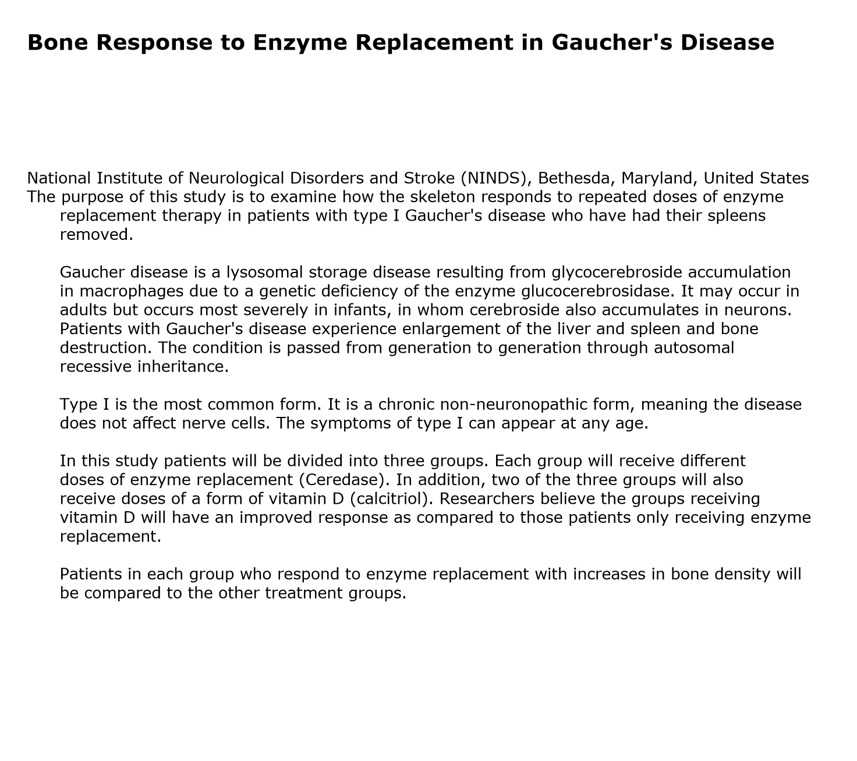
What are we going to do in this workshop?
Show you how you can use Knowledge Mining to find the most meaningful and relevant information in your data
Explore 100+ clinical trials in that are in unstructured PDFs
Notes:
Show you how Knowledge Mining can be useful to unlock valuable information hidden in your data that you can use to make decisions or perform an action.
Give you a good understanding of how to use Azure Search.
A clinical trial is a type of research that studies a test or treatment

Slide 53
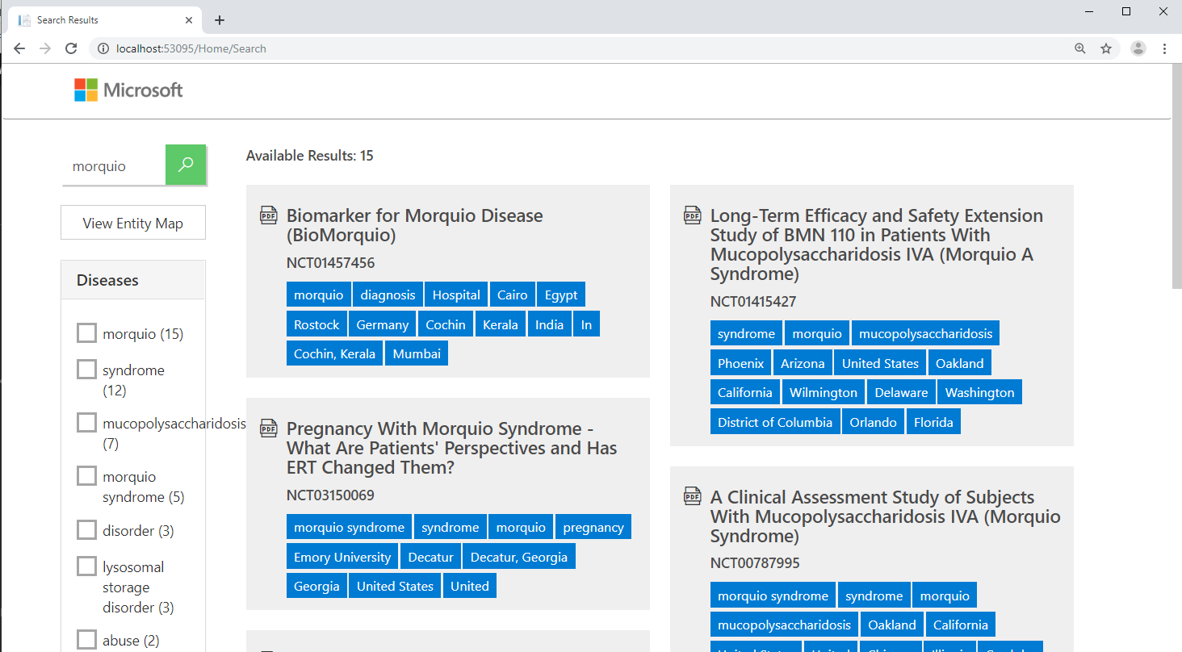
Build a search index and web front end
Azure Portal
REST APIs
Data Source
Skillset (built-in skills and custom skills)
Index
Indexer
Advanced Azure Search Concepts

Slide 54
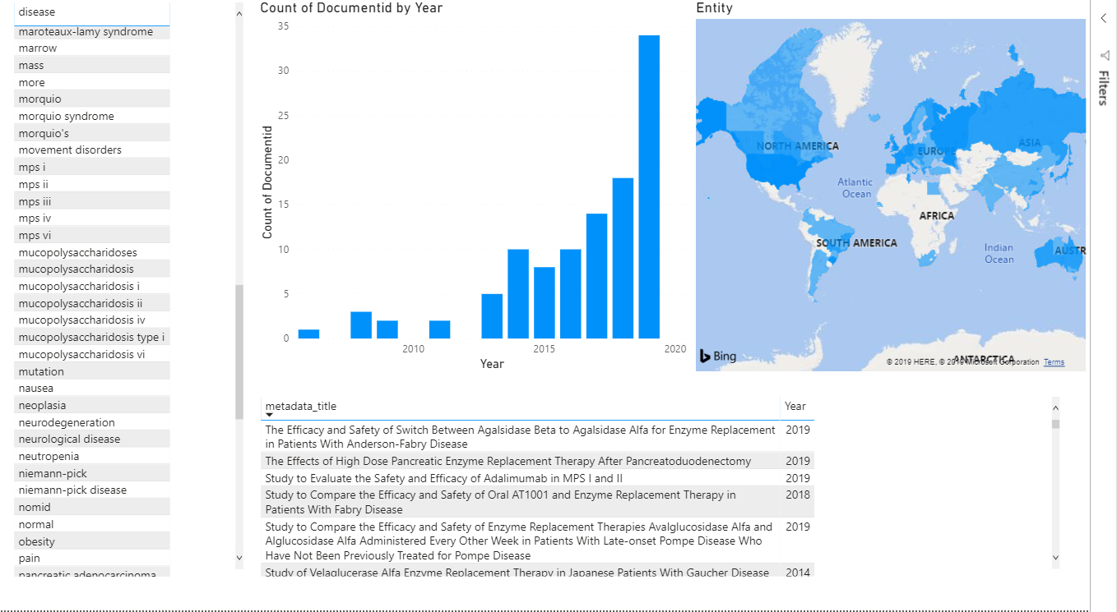
Project data into powerful visuals
Knowledge Store
PowerBI
Notes:
Projections

Slide 55
Module 0
Goal
Complete the pre-requisites so that you can complete the full workshop
Tools
Link to workshop: https://aka.ms/kmw1

Slide 56
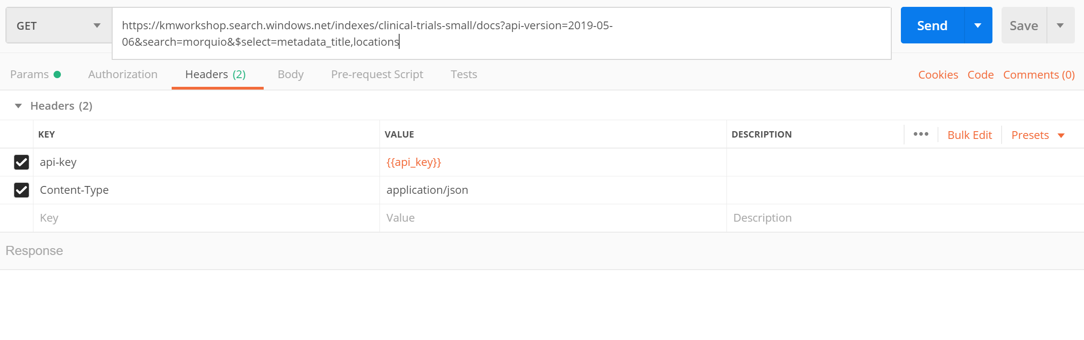
Module 1
Goals
Learn to use the Azure Portal to create your index
Learn to search your index using the Azure Portal and Postman
Tools
Azure Search
Azure Portal
Postman

Slide 57
Cognitive Search A new capability of Azure Search
IEnricher
IEnricher
Cognitive Skill
Document Cracking
Skillset:
Extensible enrichment
pipeline
Source Data
Enriched Documents
Search Index
INGEST
ENRICH
EXPLORE
Notes:
New!!
As you saw, the Cognitive Search pipeline contains a number of AI-driven capabilities (image extraction, entity and key phrase extraction, language detection and more) not just extracting information, but enriching it with additional metadata.
But we know that you business scenario may have unique needs beyond these core skills, so we also provide you with the ability to add custom skills…..

Slide 58
Warning: About to enter more technical content

Slide 59
Module 2
Goal
Learn to visualize results with a demo front-end
Tools
Azure Search
Visual Studio
Solution accelerator (http://aka.ms/kmsolution)

Slide 60
Module 3
Goals
Learn custom skill requirements.
Learn how to create a custom skill using Azure Functions.
Awareness of PowerSkills
Tools
Azure Search
Visual Studio
Azure Functions
Azure Search Power Skill (CustomEntitySearch) http://aka.ms/powerskills
Postman

Slide 61

Custom skill
{
"values": [
{
"recordId": "1",
"data": {
“Entities": [
{ "name": "diabetes",
"matchIndex": 31
}
],
"EntitiesFound": [ "diabetes“ ]
},
"errors": [],
"warnings": []
}
]
}
{
"values": [
{
"recordId": "1", "data": { "text": "This is a 53-year-old man with diabetes."
}
}
]
}
Custom Entity Search
https
Notes:
Change colors so values stand out.

Slide 62
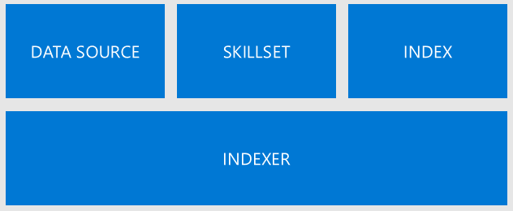
Module 4
Goals
Learn about the object model
Learn to update an index, skillset, and indexer using REST APIs
Tools
Azure Search
Azure Portal
Postman

Slide 63
The Object Model
DATA SOURCE
SKILLSET
INDEX
INDEXER
Notes:
More specifically in the programming model for Azure Search there are 4 elements.
The Data source contains all the metadata needed to connect to your data. It contains information such as the connection string and the container where your data is.
The Index has information about the search index (and the shape of that index, which fields are sortable, retrievable, etc.)
The Skillset contains information about each of the enrichment steps and their dependencies.
And the indexer has pointers to the other 3 and is in charge of taking data from the data source, running the skillset and pushing the data into the index.
Let’s go a bit deeper into the skillset.

Slide 64
Indexer (The Master Orchestrator)
Get data from the Data Source
Transform Data: Field Mappings
Run it through a Skillset
Transform Data: Output Field Mappings
Push the data to a Searchable Index
DATA SOURCE
SKILLSET
INDEX
INDEXER
Notes:
More specifically in the programming model for Azure Search there are 4 elements.
The Data source contains all the metadata needed to connect to your data. It contains information such as the connection string and the container where your data is.
The Index has information about the search index (and the shape of that index, which fields are sortable, retrievable, etc.)
The Skillset contains information about each of the enrichment steps and their dependencies.
And the indexer has pointers to the other 3 and is in charge of taking data from the data source, running the skillset and pushing the data into the index.
Let’s go a bit deeper into the skillset.

Slide 65
Indexer Step 1: Document Cracking
0
normalized_images
1
Document Cracking
document
2
content:
metadata_storage_path:
Structured or Unstructured Data

Slide 66
Let’s go deeper into the Skillset
DATA SOURCE
SKILLSET
INDEX
INDEXER
Notes:
More specifically in the programming model for Azure Search there are 4 elements.
The Data source contains all the metadata needed to connect to your data. It contains information such as the connection string and the container where your data is.
The Index has information about the search index (and the shape of that index, which fields are sortable, retrievable, etc.)
The Skillset contains information about each of the enrichment steps and their dependencies.
And the indexer has pointers to the other 3 and is in charge of taking data from the data source, running the skillset and pushing the data into the index.
Let’s go a bit deeper into the skillset.

Slide 67
Understanding how skills operate
Dear skill,
Please add a description to each of the normalized images.
Forever grateful,
@superdev
0
normalized_images
1
document
2
content:
metadata_storage_path:

Slide 68
Understanding how skills operate
{
"@odata.type":
"#Microsoft.Skills.Vision.ImageAnalysisSkill",
"context":
"/document/normalized_images/*",
"visualFeatures": [ "Description“ ],
"inputs": [
{
"name": "image",
"source": "/document/normalized_images/*"
}
],
"outputs": [
{
"name": "description",
"targetName": “pictureDescription",
}
]
}
0
normalized_images
1
document
2
content:
metadata_storage_path:

Slide 69
Understanding how skills operate
{
"@odata.type":
"#Microsoft.Skills.Vision.ImageAnalysisSkill",
"context":
"/document/normalized_images/*",
"visualFeatures": [ "Description“ ],
"inputs": [
{
"name": "image",
"source": "/document/normalized_images/*"
}
],
"outputs": [
{
"name": "description",
"targetName": “pictureDescription",
}
]
}
{
"@odata.type":
"#Microsoft.Skills.Vision.ImageAnalysisSkill",
"context":
"/document/normalized_images/*",
"visualFeatures": [ "Description“ ],
"inputs": [
{
"name": "image",
"source": "/document/normalized_images/*"
}
],
"outputs": [
{
"name": "description",
"targetName": “pictureDescription",
}
]
}
0
normalized_images
1
document
2
content:
metadata_storage_path:

Slide 70
Understanding how skills operate
{
"@odata.type":
"#Microsoft.Skills.Vision.ImageAnalysisSkill",
"context":
"/document/normalized_images/*",
"visualFeatures": [ "Description“ ],
"inputs": [
{
"name": "image",
"source": "/document/normalized_images/*"
}
],
"outputs": [
{
"name": "description",
"targetName": “pictureDescription",
}
]
}
{
"@odata.type":
"#Microsoft.Skills.Vision.ImageAnalysisSkill",
"context":
"/document/normalized_images/*",
"visualFeatures": [ "Description“ ],
"inputs": [
{
"name": "image",
"source": "/document/normalized_images/*"
}
],
"outputs": [
{
"name": "description",
"targetName": “pictureDescription",
}
]
}
0
normalized_images
1
document
2
content:
metadata_storage_path:

Slide 71
Understanding how skills operate
{
"@odata.type":
"#Microsoft.Skills.Vision.ImageAnalysisSkill",
"context":
"/document/normalized_images/*",
"visualFeatures": [ "Description“ ],
"inputs": [
{
"name": "image",
"source": "/document/normalized_images/*"
}
],
"outputs": [
{
"name": "description",
"targetName": “pictureDescription",
}
]
}
{
"@odata.type":
"#Microsoft.Skills.Vision.ImageAnalysisSkill",
"context":
"/document/normalized_images/*",
"visualFeatures": [ "Description“ ],
"inputs": [
{
"name": "image",
"source": "/document/normalized_images/*"
}
],
"outputs": [
{
"name": "description",
"targetName": “pictureDescription",
}
]
}
0
normalized_images
1
document
2
content:
metadata_storage_path:

Slide 72
Understanding how skills operate
{
"@odata.type":
"#Microsoft.Skills.Vision.ImageAnalysisSkill",
"context":
"/document/normalized_images/*",
"visualFeatures": [ "Description“ ],
"inputs": [
{
"name": "image",
"source": "/document/normalized_images/*"
}
],
"outputs": [
{
"name": "description",
"targetName": “pictureDescription",
}
]
}
{
"@odata.type":
"#Microsoft.Skills.Vision.ImageAnalysisSkill",
"context":
"/document/normalized_images/*",
"visualFeatures": [ "Description“ ],
"inputs": [
{
"name": "image",
"source": "/document/normalized_images/*"
}
],
"outputs": [
{
"name": "description",
"targetName": “pictureDescription",
}
]
}
0
normalized_images
1
document
2
content:
metadata_storage_path:

Slide 73
Understanding how skills operate
{
"@odata.type":
"#Microsoft.Skills.Vision.ImageAnalysisSkill",
"context":
"/document/normalized_images/*",
"visualFeatures": [ "Description“ ],
"inputs": [
{
"name": "image",
"source": "/document/normalized_images/*"
}
],
"outputs": [
{
"name": "description",
"targetName": “pictureDescription",
}
]
}
{
"@odata.type":
"#Microsoft.Skills.Vision.ImageAnalysisSkill",
"context":
"/document/normalized_images/*",
"visualFeatures": [ "Description“ ],
"inputs": [
{
"name": "image",
"source": "/document/normalized_images/*"
}
],
"outputs": [
{
"name": "description",
"targetName": “myDescription",
}
]
}
0
0
myDescription
normalized_images
1
normalized_images
1
myDescription
document
document
2
2
myDescription
content:
content:
metadata_storage_path:
metadata_storage_path:

Slide 74
Understanding how skills operate
{
"@odata.type":
"#Microsoft.Skills.Vision.ImageAnalysisSkill",
"context":
"/document/normalized_images/*",
"visualFeatures": [ "Description“ ],
"inputs": [
{
"name": "image",
"source": "/document/normalized_images/*"
}
],
"outputs": [
{
"name": "description",
"targetName": “pictureDescription",
}
]
}
{
"@odata.type":
"#Microsoft.Skills.Vision.ImageAnalysisSkill",
"context":
"/document/normalized_images/*",
"visualFeatures": [ "Description“ ],
"inputs": [
{
"name": "image",
"source": "/document/normalized_images/*"
}
],
"outputs": [
{
"name": "description",
"targetName": “myDescription",
}
]
}
0
myDescription
normalized_images
1
myDescription
document
2
myDescription
content:
metadata_storage_path:

Slide 75
Sample skillset
text
organization entity recognition
merge text
printed text recognition
location entity recognition
object detection
persons entity recognition
images
face detection
Notes:
This is what a sample skillset looks like.
A few things to notice.
It takes as input the fields that were found in your data source… or in the case of unstructured content, the output of the document cracking stage… which includes any text found in the document. We usually call this “content”, as well as any “normalized images” extracted during the document cracking stage.
So in this example. We are taking the images and doing several steps on it….

Slide 76
Look at Sample Skillset Definition

Slide 77
Understanding Output Field Mappings
0
myDescription
normalized_images
1
Field Name
Type
myDescription
Output Field Mappings
descriptions
Collection(Str)
document
…
…
2
myDescription
content:
Search Index
metadata_storage_path:

Slide 78
Understanding Output Field Mappings
Indexer Definition
…
"outputFieldMappings":
[
{
"sourceFieldName":
"/document/normalized_images/*/myDescription",
"targetFieldName":
“descriptions",
}
]
0
myDescription
normalized_images
1
Field Name
Type
myDescription
descriptions
Collection(Str)
document
…
…
2
myDescription
content:
Search Index
metadata_storage_path:

Slide 79
Module 5
Goals
Learn about custom analyzers
Learn about scoring profiles
Tools
Azure Search
Postman
Azure Portal

Slide 80
Search indexes
Token | Documents
first | [ 1, 2 ]
blood | [ 1, 2, 5 ]
rambo | [ 2, 3, 4, 5 ]
last | [ 5 ]
part | [ 2 ]
Documents: [
{ #1, “First blood” },
{ #2, “Rambo: First Blood Part II” }
{ #3, “Rambo III” }
{ #4, “Rambo” }
{ #5, “Rambo: Last Blood”}
]

Slide 81
Custom Analyzers
Char filters
Mapping
Tokenizer
Language specific
Token filters
Ascii folding
Stripping html
Pattern
Pattern
Path hierarchy
nGram
Keyword
Length filters
Lowercase
Phonetic
Input document text
Tokens

Slide 82
Search indexes
Token | Document Frequency | Documents
first | 2 | [ 1, 2 ]
blood | 3 | [ 1, 2, 5 ]
rambo | 4 | [ 2, 3, 4, 5 ]
last | 1 | [ 5 ]
part | 1 | [ 2 ]
TF * IDF

Slide 83
Module 6
Goals
Learn how visualize data using PowerBI
Tools
Azure Search
Azure Storage Explorer
PowerBI

Slide 84
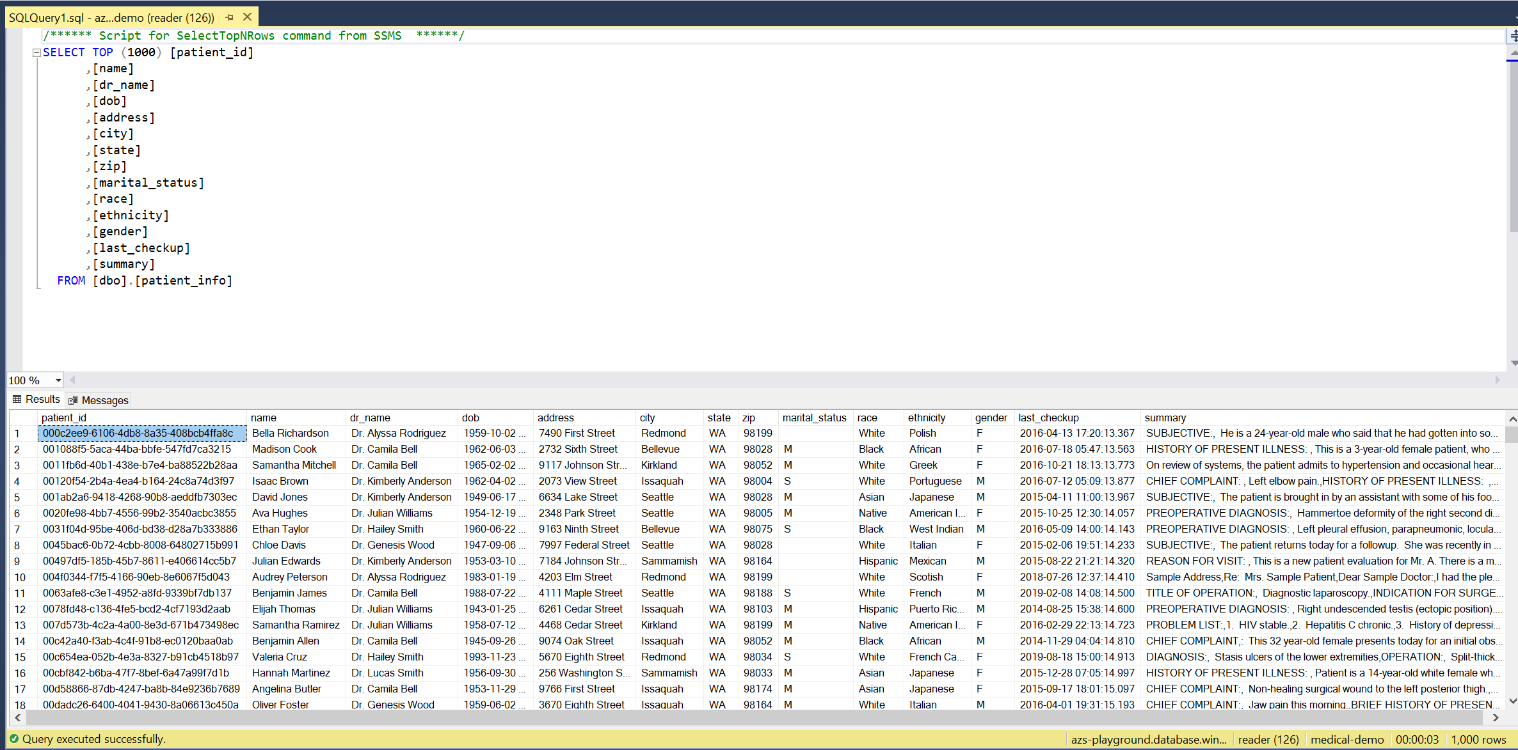
Module 7
Goals:
Learn how to index using Azure SQL
Tools:
Azure Search
Postman

Slide 85
Thank you! Survey - https://aka.ms/km

